Slide 1
Read Before Use
Thanks for downloading
01
Download and install Lato Font before editing this template, in order to see it as you found it https://free-powerpoint-templates-download.com/ otherwise the font will change and your template would look different.
02
Someone said: “Creativity is the key to success in the future”, you can use this template as you want, use your creativity and change colors, icons and image according to your brand.
03
You won’t find some images, this will allow to use yours, the images used were found on https://www.freepik.es - https://pixabay.com/es/ there you can find another ones if you want for free. And of course, you can changed it for yours.
04
Enjoy, if you like this template don’t forget to let us your comment and share on your social media, another person will thank you. Remember to come back, we will be uploading more options so that you can continue impressing your audience.

Slide 2

FAMILY
POWERPOINT TEMPLATE
https://free-powerpoint-templates-download.com/

Slide 3

Your Title
Goes Here
1
Element One
Entrepreneurial activities differ substantially depending on the type of organization and creativity involved. Entrepreneurship ranges in scale from solo
2
Element Two
Entrepreneurial activities differ substantially depending on the type of organization and creativity involved. Entrepreneurship ranges in scale from solo
3
Element Three
Entrepreneurial activities differ substantially depending on the type of organization and creativity involved. Entrepreneurship ranges in scale from solo
4
Element Four
Entrepreneurial activities differ substantially depending on the type of organization and creativity involved. Entrepreneurship ranges in scale from solo

Slide 4

Your Title
Goes Here
Entrepreneurial activities differ substantially depending on the type of organization and creativity involved. Entrepreneurship ranges in scale from solo, part-time projects to large-scale.
Entrepreneurial activities differ substantially depending on the type of organization and creativity involved. Entrepreneurship ranges in scale from solo, part-time projects to large-scale undertakings that create
Entrepreneurial activities differ substantially depending on the type of organization and creativity involved. Entrepreneurship ranges in scale from solo, part-time projects to large-scale.

Slide 5
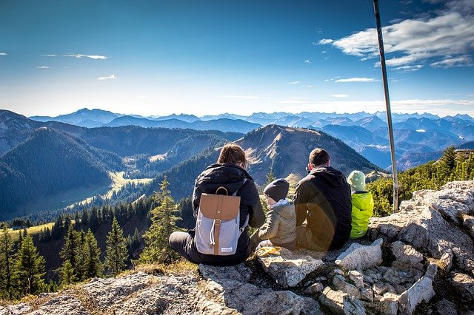
Your Title
Goes Here
Element One
Entrepreneurial activities differ substantially depending on the type of organization and creativity involved. Entrepreneurship ranges in scale from solo
Element Two
Entrepreneurial activities differ substantially depending on the type of organization and creativity involved. Entrepreneurship ranges in scale from solo
Element Three
Entrepreneurial activities differ substantially depending on the type of organization and creativity involved. Entrepreneurship ranges in scale from solo

Slide 6

Your Title
Goes Here
1
2
3
Entrepreneurial activities differ substantially depending on the type of organization and creativity involved. Entrepreneurship ranges in scale from solo
Entrepreneurial activities differ substantially depending on the type of organization and creativity involved. Entrepreneurship ranges in scale from solo
Entrepreneurial activities differ substantially depending on the type of organization and creativity involved. Entrepreneurship ranges in scale from solo
Entrepreneurial activities differ substantially depending on the type of organization and creativity involved. Entrepreneurship ranges in scale from solo
Entrepreneurial activities differ substantially depending on the type of organization and creativity involved. Entrepreneurship ranges in scale from solo
Entrepreneurial activities differ substantially depending on the type of organization and creativity involved. Entrepreneurship ranges in scale from solo

Slide 7

Your Title
Goes Here
Entrepreneurial activities differ substantially depending on the type of organization and creativity involved. Entrepreneurship ranges in scale from solo, part-time projects to large-scale.
Entrepreneurial activities differ substantially depending on the type of organization and creativity involved. Entrepreneurship ranges in scale from solo, part-time projects to large-scale undertakings that create
Entrepreneurial activities differ substantially depending on the type of organization and creativity involved. Entrepreneurship ranges in scale from solo, part-time projects to large-scale.

Slide 8
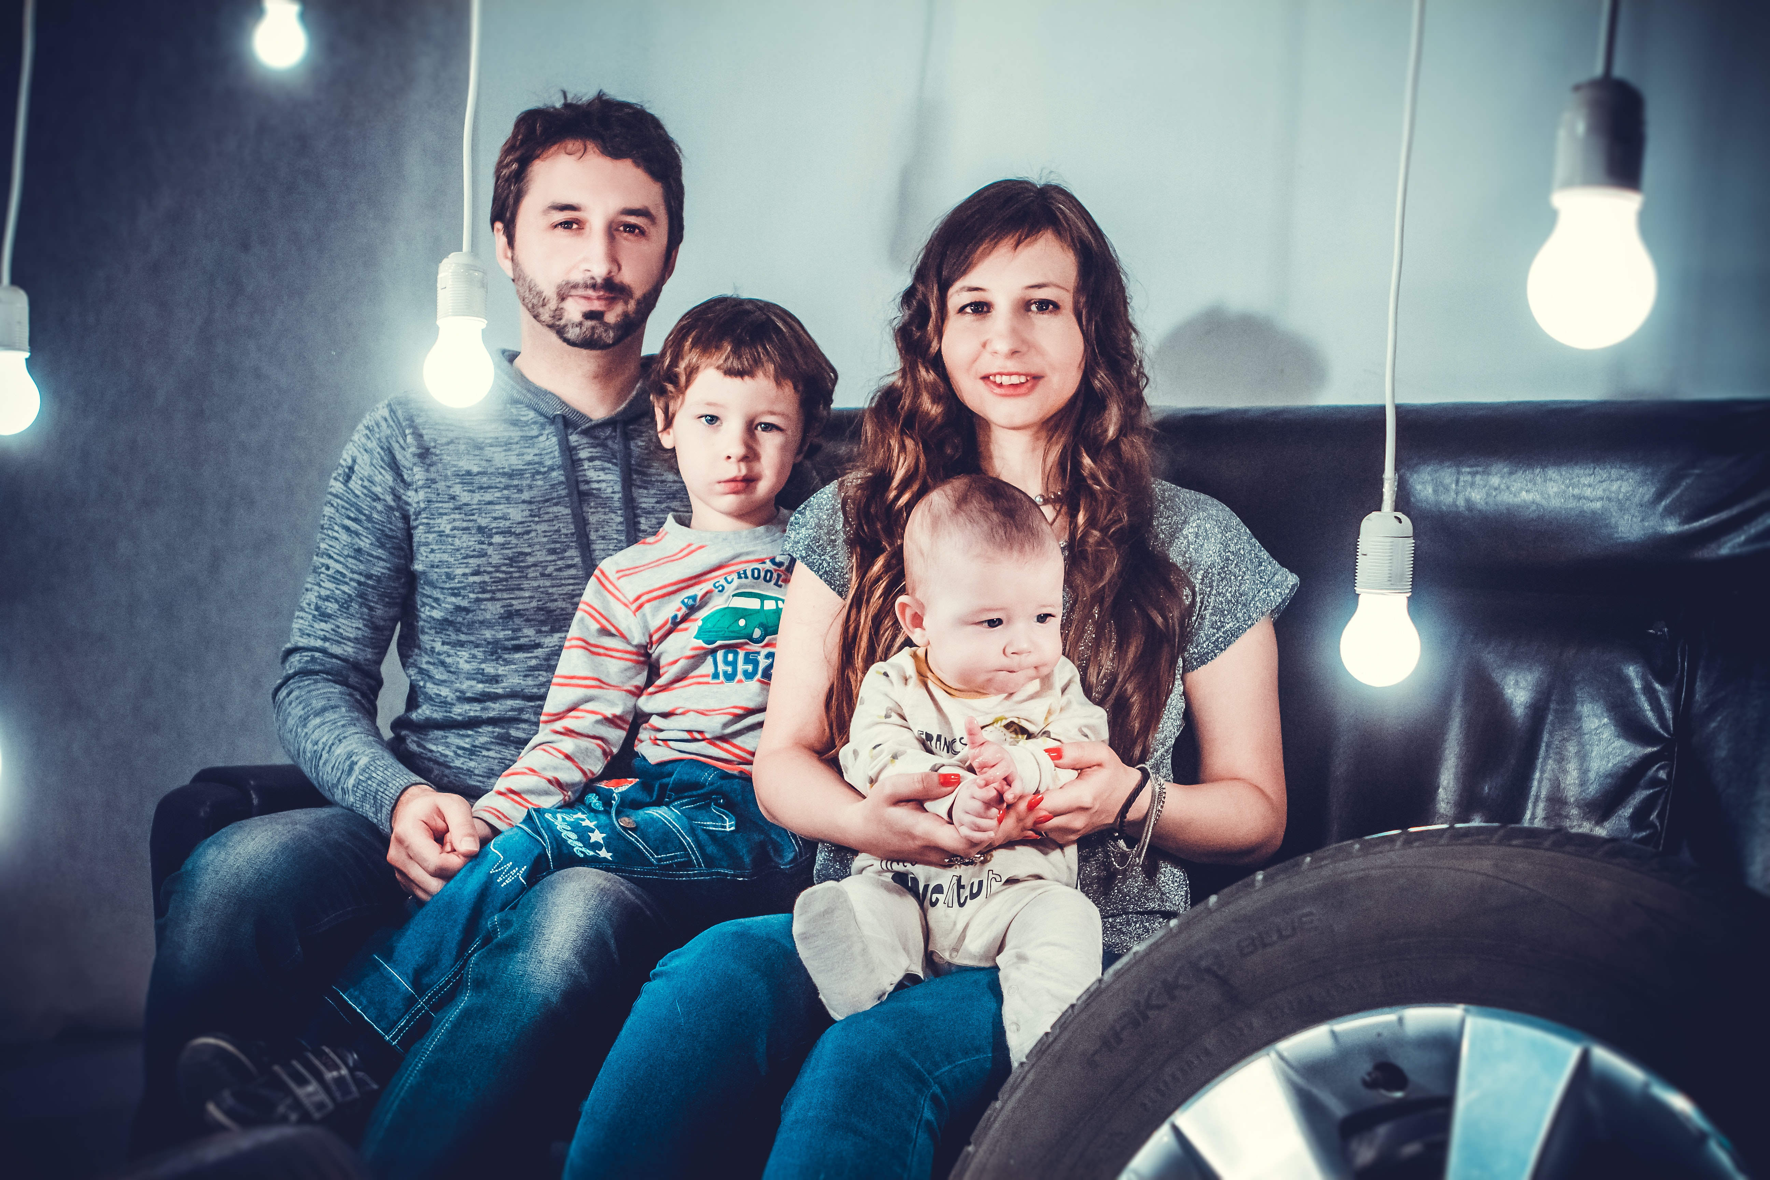
Your Title
Goes Here
Entrepreneurial activities differ substantially depending on the type of organization and creativity involved. Entrepreneurship ranges in scale from solo, part-time projects to large-scale.
Entrepreneurial activities differ substantially depending on the type of organization and creativity involved. Entrepreneurship ranges in scale from solo, part-time projects to large-scale undertakings that create
Entrepreneurial activities differ substantially depending on the type of organization and creativity involved. Entrepreneurship ranges in scale from solo, part-time projects to large-scale.

Slide 9

Your Title
Goes Here
Entrepreneurial activities differ substantially depending on the type of organization and creativity involved. Entrepreneurship ranges in scale from solo, part-time projects to large-scale.
Entrepreneurial activities differ substantially depending on the type of organization and creativity involved. Entrepreneurship ranges in scale from solo, part-time projects to large-scale undertakings that create
Entrepreneurial activities differ substantially depending on the type of organization and creativity involved. Entrepreneurship ranges in scale from solo, part-time projects to large-scale.

Slide 10
Your Title
Goes Here
Element One
Element One
Entrepreneurial activities differ substantially depending on the type of organization and creativity involved. Entrepreneurship ranges in scale from solo
Entrepreneurial activities differ substantially depending on the type of organization and creativity involved. Entrepreneurship ranges in scale from solo

Slide 11
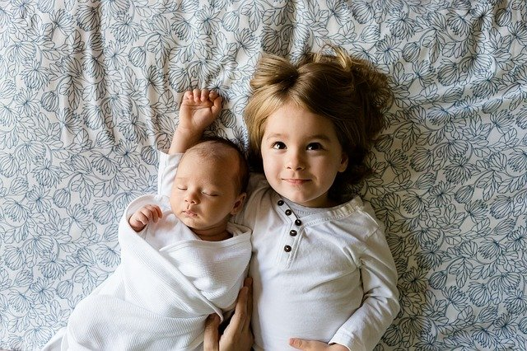
Your Title
Goes Here
Entrepreneurial activities differ substantially depending on the type of organization and creativity involved. Entrepreneurship ranges in scale from solo, part-time projects to large-scale.
Entrepreneurial activities differ substantially depending on the type of organization and creativity involved. Entrepreneurship ranges in scale from solo, part-time projects to large-scale undertakings that create
Entrepreneurial activities differ substantially depending on the type of organization and creativity involved. Entrepreneurship ranges in scale from solo, part-time projects to large-scale.
20%
Are Happy Families

Slide 12
Your Title
Goes Here
Entrepreneurial activities differ substantially depending on the type of organization and creativity involved. Entrepreneurship ranges in scale from solo, part-time projects to large-scale.
Entrepreneurial activities differ substantially depending on the type of organization and creativity involved. Entrepreneurship ranges in scale from solo, part-time projects to large-scale undertakings that create

Slide 13
THANKS
https://free-powerpoint-templates-download.com/

Slide 14
Thanks for downloading this template
https://free-powerpoint-templates-download.com/
www.slidesgratis.com
Pics: https://www.freepik.es/ www.Pixabay.com

